Slide 1
Energy Demand Forecasting

Slide 2
Internet of Things (IoT), alternative energy sources, and big data have merged to create vast opportunities in the utility and energy sector. Simultaneously, the utility and energy sector have seen consumption flattening out and consumers demanding better ways to control their use of energy. To be effective and efficient, utility and smart grid companies need to innovate and renew themselves.
Demand forecasts play an important role in empowering the energy sector to realize current and future business value and have become the building block for future use cases. These use cases include short and long-term power load forecasting, trading, load balancing, grid optimization, lowering costs and optimizing revenue potential.
Big data and advanced analytics methods, such as Machine Learning, are the key enablers for producing accurate and meaningful forecasts.

Slide 3
Energy Sector | Benefits of Demand Forecasting
Controls
Cost
Prevents
Energy Wastage
Reduces Greenhouse Gas Emission
Determines Production Volumes
Forecasts
Future Demand & Price
Balances
Supply and Demand

Slide 4
Production is a main focus because it cannot be accumulated or stored.
What is produced, must be used

Slide 5
Energy Demand Forecasting

Slide 6
Energy Sector | Types of Demand Forecasting
Demand forecasting can help solve critical business problems in many ways and can be used as the foundation for many other use cases in the industry. Generally speaking there are two types of energy demand forecasts. It is important to distinguish between these forecast scenarios because they represent different business needs and have different deployment and consumption patterns.
Short Term Forecasting
These are forecasts that are no further out than 48 hours and are commonly used for operational use cases. These models use real-time and near present data. They are less sensitive to seasonal patterns or long-term consumption trends.
Long Term Forecasting
These models are usually from 1 week to a multiple years and are commonly used for planning and investment use cases. They rely on a minimum of 3 years of quality data where they extract seasonality patterns and make use of external predictors.

Slide 7
Energy Sector | Types of Demand Forecasting
Short Term Forecasting
Long Term Forecasting
Forecast Frequency
typically produced every hour or 24 hours
typically produced once a week, month or quarter
Prediction Accuracy
typically MAPE* of 5% or lower
typically MAPE* of 15% or lower
Day or week
Hour of Day
Hourly Temp.
Predictors
Month of Year
Day of Month
Long term temp. & climate
Historical Data
2-3 years' worth of data
0001
1110
1010
0101
0001
1110
1010
0101
5-10 years' worth of data
1110
1010
0101
1110
1010
0101
0101
0101
Use Cases
Demand/Supply Balancing
Demand Response
Pick Hour Forecasting
Long Term Planning
Resource Planning
Grid Asset Planning
*MAPE: Mean Absolute Percentage Error

Slide 8
Energy Sector | Solution Development Process
i
Uses an ongoing, dynamic flow of data sourced directly from smart meters or from data already aggregated on an on-premise database
Utilizes the most advanced algorithms and performs data preparation, feature extraction, modelling, and model evaluation
Ingests weather data
Uses historical and real time data
Azure Data Factory orchestrates and schedules the data
Collect
Model
Output is a working model that is fully evaluated and ready for deployment
Uses the forecasting model to produce predictions
Consume
Deploy
The model is converted into a web service that can be accessed from Web-connected devices
Can be driven from an application (e.g., dashboard), directly from an operational system or a grid optimization solution
Forecasting model can be deployed directly and simply with a single click
Multiple use cases can be driven from a single model
Solution automatically scales to meet the consumption
Notes:
Data Collection:
Data can be sourced directly from smart meters, or be already aggregated on an on premise database
This ongoing flow of data must be orchestrated, scheduled & stored using Azure Data Factory
Modelling:
Azure ML Studio utilizes the most advanced ML algorithms & perform data preparation, feature extraction, & model evaluation
Output of this phase is a working model that is fully evaluated & ready for deployment
Deployment:
Model is converted into a web service exposing a restful API
Azure ML provides a simple way of deploying a model directly from the Azure ML Studio with a single click
Consumption:
This phase make use of the forecasting model to produce predictions
The consumption can be driven from a user app or directly from operational system such as demand/ supply balancing system

Slide 9
Energy Sector | Demand Forecast End-to-End Data Flow
Big Data Storage
Data Processing
Data Ingestion
Scoring to create Forecast Data
Training Machine Learning Model
Big Data Storage
Reports and Visualization
Power Grid

Slide 10
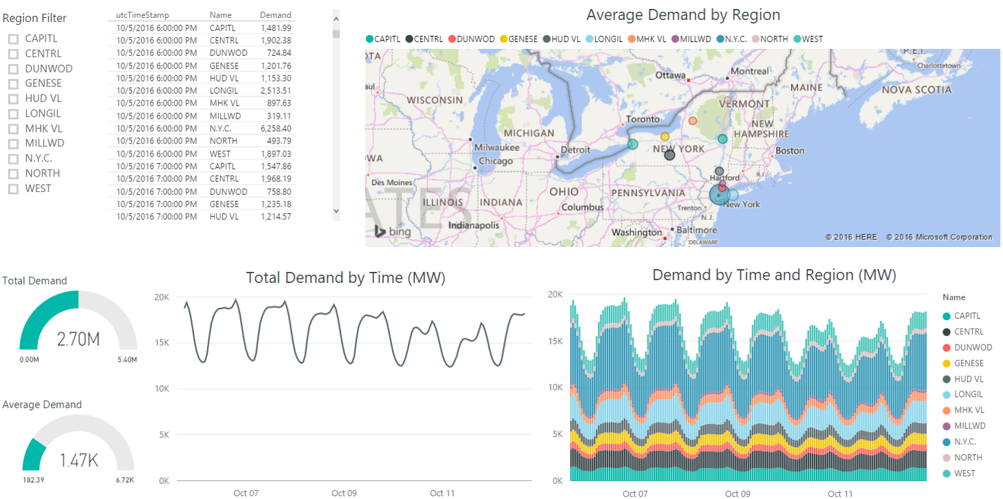
Energy Demand Forecasting | Dashboard Example

Slide 11
Demand Forecast Solution | Business Case Justification

Slide 12
Cortana Intelligence Suite

Slide 13
Cortana Intelligence Suite | Overview
Information Management
Big Data Stores
Machine Learning and Analytics
Intelligence
People
Data Sources
Machine Learning
Cognitive Services
Data Factory
Data Lake Store
Data Catalog
SQL Data
Warehouse
Data Lake Analytics
Bot Framework
Web
Event Hubs
HDInsight
Cortana
Mobile
Apps
Stream Analytics
Bots
Sensors and devices
Dashboards & Visualizations
Power BI
Automated Systems
Data
Intelligence
Action
Notes:
Cortana Intelligence Suite delivers an end-to-end platform with integrated and comprehensive set of tools and services to help you build intelligent applications that let you easily take advantage of Advanced Intelligence.
First Cortana Intelligence Suite provides services to bring data in, so that you can analyze it. It provides information management capabilities like Azure Data Factory so that you can pull data from any source (relational DB like SQL or non-relational ones like your Hadoop cluster) in an automated and scheduled way, while performing the necessary data transforms (like setting certain data columns as dates vs. currency etc.). Think ETL (Extract, Transform, Load) in the cloud. Event hub does the same for IoT type ingestion of data that streams in from lots of end points.
The data brought in then can be persisted in flexible big data storage services like Data Lake and Azure SQL DW.
You can then use a wide range of analytics services from Azure ML to Azure HDInsight to Azure Stream Analytics to analyze the data that are stored in the big data storage. This means you can create analytics services and models specific to your business need (say real time demand forecasting).
The resultant analytics services and models created by taking these steps can then be surfaced as interactive dashboards and visualizations via Power BI
These same analytics services and models created can also be integrated into various different UI (web apps or mobile apps or rich client apps) as well as via integrations with Cortana, so end users can naturally interact with them via speech etc., and so that end users can get proactively be notified by Cortana if the analytics model finds a new anomaly (unusual growth in certain product purchases- in the case of real time demand forecasting example given above) or whatever deserves the attention of the business users.

Slide 14
Cortana Intelligence Suite | Advantages
COST
SCALABILITY
GROWTH
There are no upfront costs or COGS (Cost of Goods Sold) component costs associated. Meaning there is no need to invest in hardware, software, and/or IT maintenance. This translates into a substantial reduction in business risk.
Servers for computing and/or storage can be deployed and scaled on an as-needed basis and can be done quickly and easily. This effects the cost efficiency advantage of a cloud-based solution with a pay-for-what-is-used policy.
Features, components, and capabilities are consistently being introduced and evolved in Cortana Intelligence Suite. As such, they can easily and quickly be implemented in a cloud-based solution.
Notes:
Cortana Intelligence Suite delivers an end-to-end platform with integrated and comprehensive set of tools and services to help you build intelligent applications that let you easily take advantage of Advanced Intelligence.
First Cortana Intelligence Suite provides services to bring data in, so that you can analyze it. It provides information management capabilities like Azure Data Factory so that you can pull data from any source (relational DB like SQL or non-relational ones like your Hadoop cluster) in an automated and scheduled way, while performing the necessary data transforms (like setting certain data columns as dates vs. currency etc.). Think ETL (Extract, Transform, Load) in the cloud. Event hub does the same for IoT type ingestion of data that streams in from lots of end points.
The data brought in then can be persisted in flexible big data storage services like Data Lake and Azure SQL DW.
You can then use a wide range of analytics services from Azure ML to Azure HDInsight to Azure Stream Analytics to analyze the data that are stored in the big data storage. This means you can create analytics services and models specific to your business need (say real time demand forecasting).
The resultant analytics services and models created by taking these steps can then be surfaced as interactive dashboards and visualizations via Power BI
These same analytics services and models created can also be integrated into various different UI (web apps or mobile apps or rich client apps) as well as via integrations with Cortana, so end users can naturally interact with them via speech etc., and so that end users can get proactively be notified by Cortana if the analytics model finds a new anomaly (unusual growth in certain product purchases- in the case of real time demand forecasting example given above) or whatever deserves the attention of the business users.

Slide 15
Appendix

Slide 16



Energy Sector | Industry Use Case
Learn more on our customer story
Business need
Solution
eSmart wanted to deploy a cloud-based solution that enables predicting the propensity of an overload situation on any given substation of the grid.
In particular, eSmart wanted to identify substations that are likely to overload within the next hour, so an immediate action could be taken to avoid or resolve that situation.
To achieve the business need, an accurate and fast performing prediction is needed which requires implementation of three predictive models.
Long term model that enables forecasting of power consumption on each substation during the next few weeks or months
Short term model that enables prediction of overload situation on a given substation during the next hour
Temperature model that provides forecasting of future temperature over multiple scenarios

